Slide 1


Nationwide’s Got Secrets!
Github DevSecOps Enterprise Control – Best Practices, expectations and Guidelines

Slide 2


Github.nwie.net -The Power of Inner sourcing
Encourage innovation
Improves healthy competition
Increased code quality
Improves collaboration
Code re-use
Faster development
……….
Applying open source methodologies to Software development .
We have an open source community behind our firewall, how cool is that!
Learn more here!

Slide 3

What Is Our Challenge Then?
We need to ensure we’re applying open source (not closed source!) methodologies to our code handling practices

Slide 4



Important Terminology ☺
Private Repos
Firewall
Not public Repos in Github.com!
Public Repos
Github.nwie.net
Nationwide
Inner Sourcing & Open Development in the context of

Slide 5
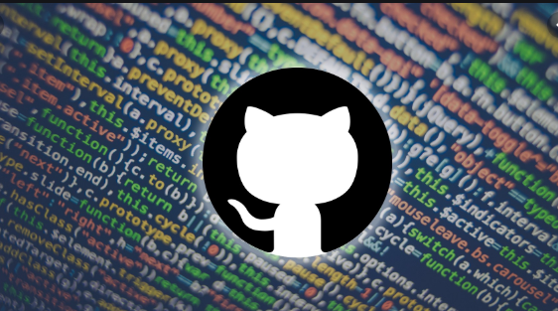
Tenets of Open Development Method – Be Intentional!
Code Quality (testable, modular,…etc)
Documentation (long live the readme and Wiki!)
What does the project do, why that’s important, how to get started, and where/who can be contacted for help/questions.
Transparency (Tell us if there are issues!)
Contributions/Expectations– If you want contributors please tell us! include a CONTRIBUTING file (what you’re looking for, roadmap/vision, how to contact you/your team)
Never open source secrets, or any confidential information!

Slide 6


DevSecOps GitHub Controls: To Help Our Teams & Protect Our Code …
Developer
Team
Enterprise
Developer Powered: Detecting secrets locally before code is pushed to Github.nwie.net
Git hooks based tools - regex based. [Gitsecrets]
Team Powered: Pipeline triggered scans for secrets
Pipeline scans – regex based. [Gitsecrets or TruffleHog]
Enterprise Powered:
Github Enterprise Scans for secrets
Recon Tools: High Entropy Scans. [TruffleHog]
Check out this video detailing our DevSecOps strategy! Don’t forget detailed info can be found on Nest!

Slide 7
To Help Our Teams & Protect Our Code …
Nationwide
Private Repos
Public Repos
Github.nwie.net
TruffleHog
e.g.: trufflehog https://github.nwie.net/youssi1/Experiments.git

Slide 8
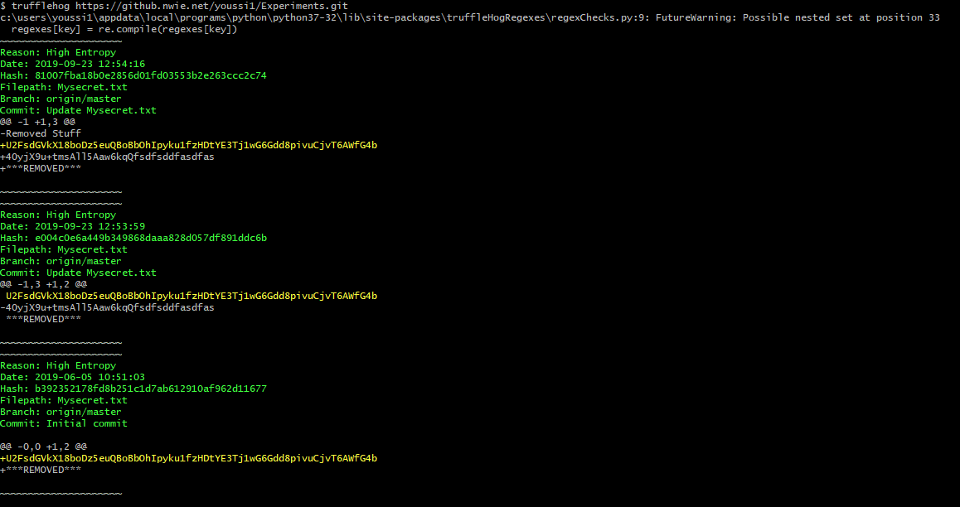
TruffleHog – Github Enterprise Scanning

Slide 9

Git-Secrets: Prevent The Leak!
Nationwide
Private Repos
Run Git-Secrets locally & in your team pipeline: It scans commits, commit messages, and --no-ff merges to prevent adding secrets into your git repositories.
Public Repos
Github.nwie.net

Slide 10

Git-Secrets In Action!
1. Clone the tool’s repo
2. Install & create a git template to install githooks for gitsecrets in any new or existing repo.
3. Configure once: configure with initial regex repo,
Done!! But don’t forget to keep updating your patterns!! Refer to our Nest article for more details! Also, you can find a great exercise in our Community of practice (DevSecOps-CoP) Git-Secrets challenge!

Slide 11

And Here’s a Docker Image for Your Pipeline Too!
Thanks to Ryan McDaniel!

Slide 12

Where Should We Put Secrets?

Slide 13


Maturity
Security
Putting Secrets in Private Repo
Putting Encrypted Secrets in Private Repo
Putting Secrets Out of Codebase, and in Vault

Slide 14
Starting? Make the Repo Private
Use Git-Secrets or Truffle Hog to find any secrets in the code.
Separate configuration & secrets from code in a separate repository and make it private while still keeping your code available for other Nationwiders.
Note: You can choose to make the whole of your repo private, but you’ll be missing up on innersourcing and contribution benefits, beside the best practice of nice clean separation of code and configuration!
There might be additional steps that’s needed in ServiceNow. Follow steps in this article to ensure you complete all necessary requirements. Also this article for deploying secrets with UCD.

Slide 15

Level Up! Encrypted Secrets in Private Repo
Once you have your secrets identified, use an encryption tool to encrypt these and store in private repo.
You have many encryption tool options, one that is particularly very easy to use is Transcrypt!
Why? Because it seamlessly encrypt files for you upon a push.

Slide 16
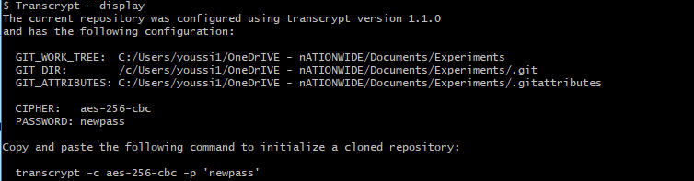
Transcrypt
Get the Transcrypt script (from here)
Cd inside the repo which contains some secrets, say in a file (mysecrets.txt), and configure the repo with Transcrypt: choose the cipher and enter a random password and get the output.
Now if anyone on your team clone this repo, they will need to know the cipher and the password to decrypt:

Slide 17
And Here’s a Docker Image for Your Pipeline Too!
Thanks to Ryan McDaniel!

Slide 18

And the Ultimate Level Up! Secrets Vault … For now we only have Cloud Native vaults (e.g., AWS Secrets Manager), we also have PIDM, but very soon we will have a hybrid reliable vault for all your (dev, test & prod) needs that serves cloud and on prem…

Slide 19

Do I Need to Cleanup? Yes Please!

Slide 20

Why Do I Need to Cleanup?
Because every commit you make is available & readable – Yep Git has your history ☺

Slide 21
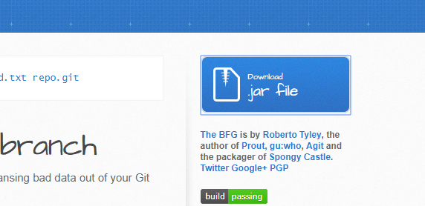
How Do I Cleanup?
Here’s the Github guide with great instructions.
Our recommendation is to use the BFG Repo Cleaner tool for easy cleanup!
Download the bfg.jar from the blue button at the top right of the tool’s Github page.
Give your team heads up.
Put the things you want cleaned in banned.txt (one per line), and cleanup ☺
Push to Github (you’ll need --force)
Ask all your team to clone a fresh copy.
$ bfg --replace-text banned.txt repo.git

Slide 22
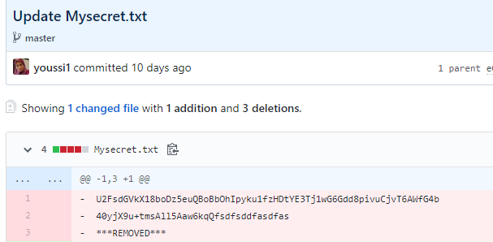
Also, it is recommended to rotate those leaked credentials as well!

Slide 23

So What To Expect From Enterprise Scan?
IRM FO Gives you some findings (if any) – tentative: 10/30/19
Validate findings and indicate false positives if any
Identify next steps for mitigation
Mitigate & cleanup - tentative: 11/30/19
IRM FO rerun the scans to validate mitigation
Ongoing prevention
By 12/31/2019 every detected secret should be in a private repo!

Slide 24
A Final Note About Code
Any code you develop using Nationwide time and/or asset is owned by the company (revisit the message on your blue login screen!).
What that means is that this code should never be shared outside of Nationwide without explicit approvals from the appropriate Nationwide committee/leader/team/…etc as defined in the open source compliance policy (any questions? Reach out to OSCC@nationwide.com)
Sharing code from Nationwide externally is a violation of the law. Our threat intel and SOC teams are doing their best to keep us safe by scanning externally to identify any such occurances, but we as developers need to practice due diligence around our code to ensure no violations happen within our team!

Slide 25
A Final Note About Code
Here’s some important considerations:
Do not post Nationwide propriety code in online instant IDEs, e.g. Repl.IT
Never check in Nationwide propriety code in Github.com
All Nationwide code should be considered propriety code unless explicitly approved for open source contribution. (please reach out to OSCC@nationwide.com for more details on contributing Nationwide code)

Slide 26




RocketChat:
DevSecOps
DevSecOps-Experiments
SCC Threat Intel Channel
Hello!
Yammer:
DevSecOps-Experiments
CoP: DevSecOps-CoP
Nest- Shared Competency
DevSecOps
DevSecOps Support!

Slide 27
Thank You!!

